Slide 1

Portfolio Website
Syeda Ismat Farjana

Slide 2
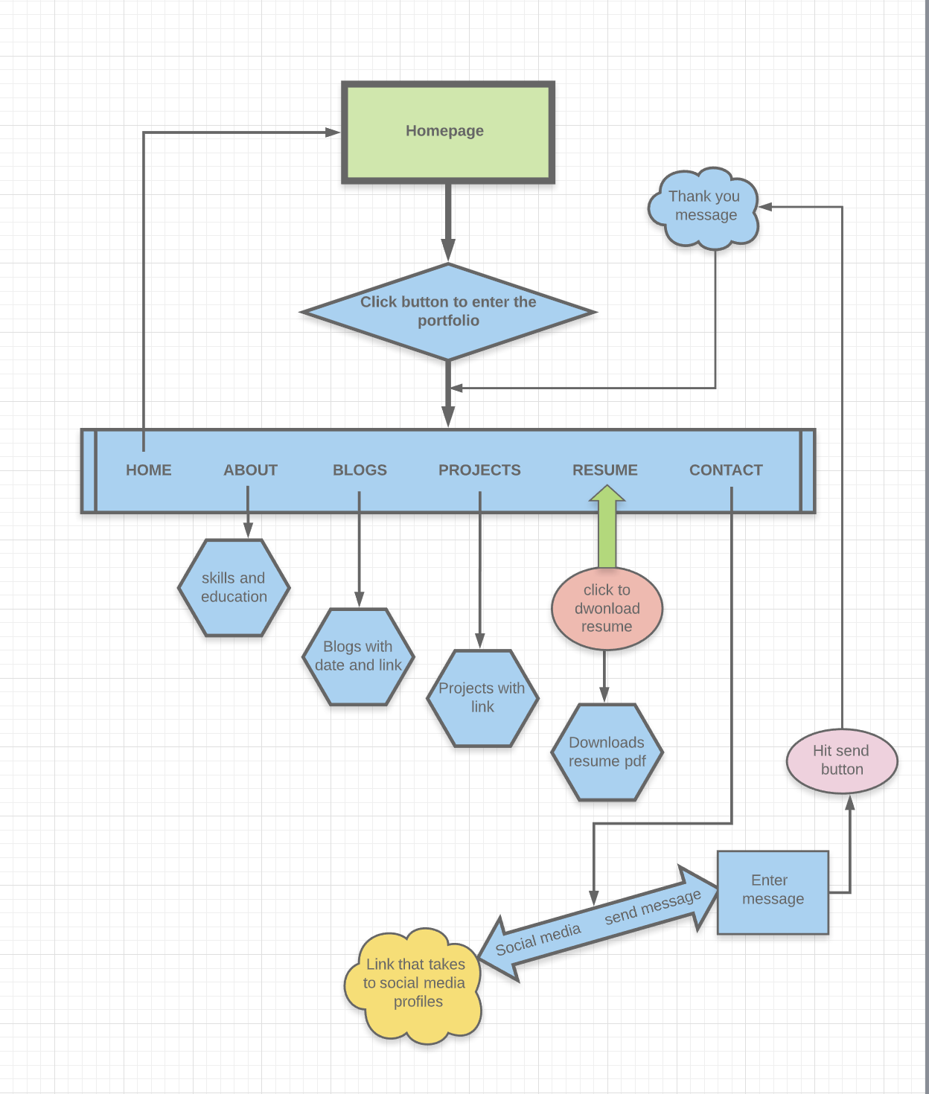
A walk-through of the website
Pages
Home
About
Blogs
Projects
Resume
Contact

Slide 3
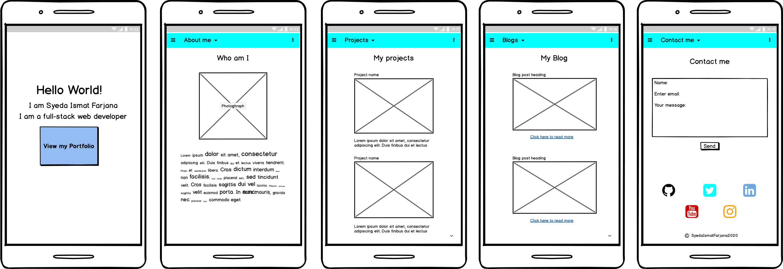
Wireframes (Mobile)

Slide 4
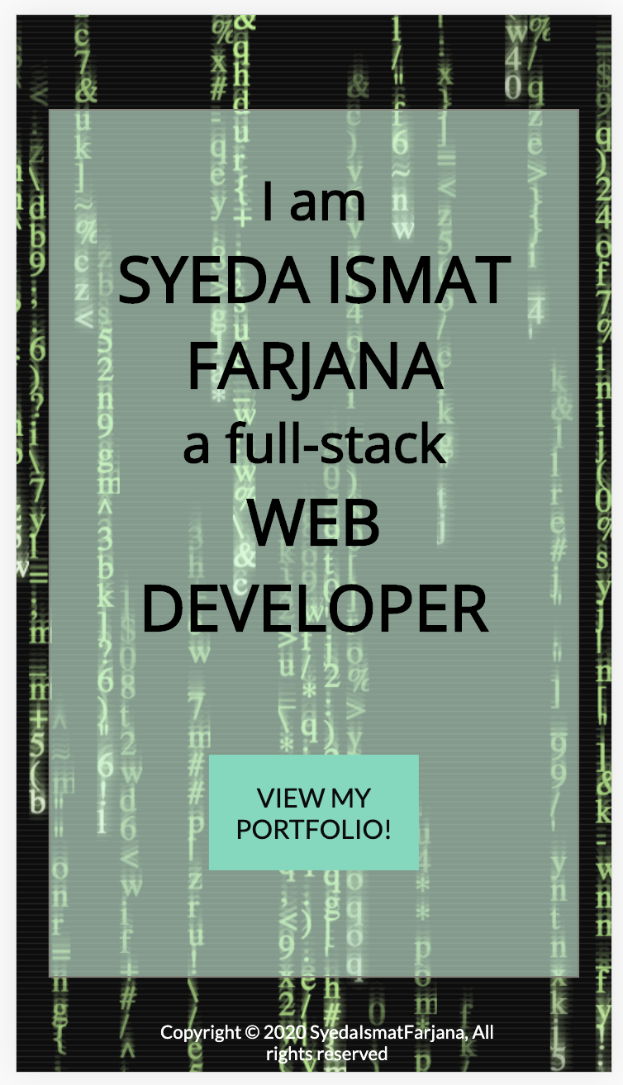
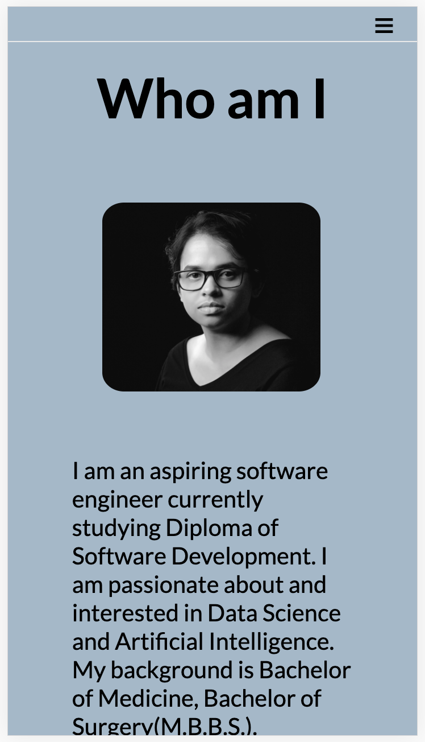
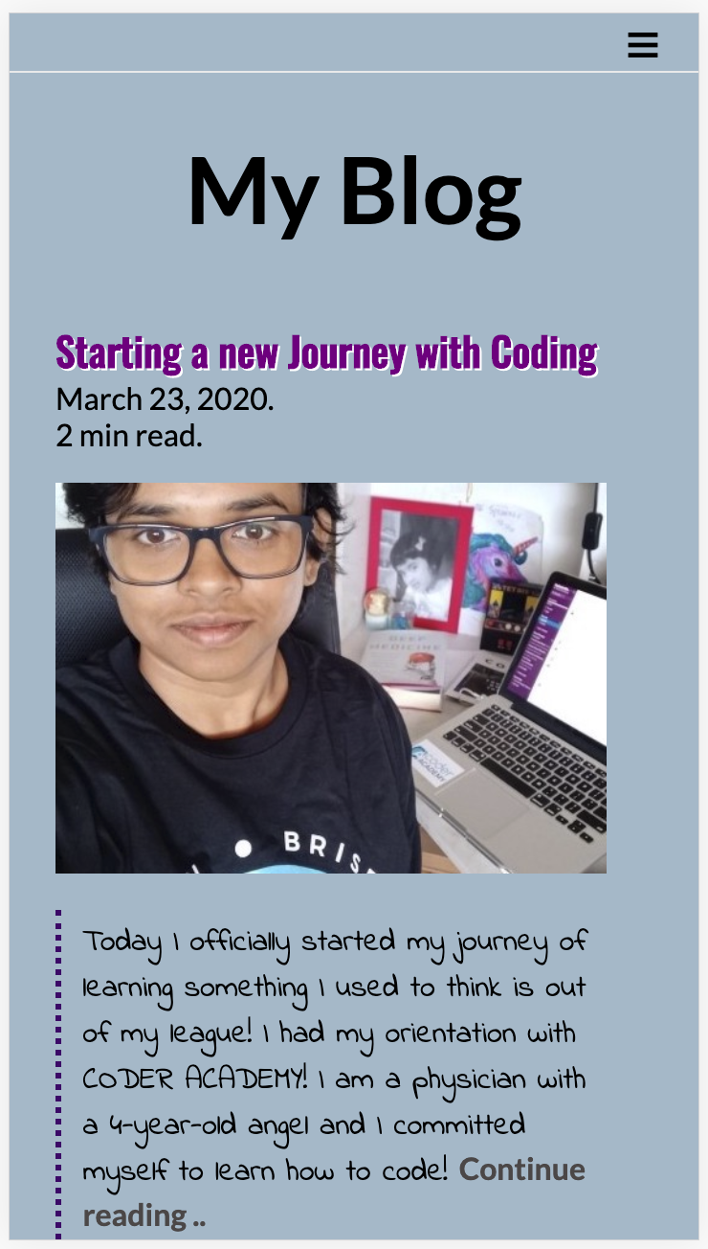
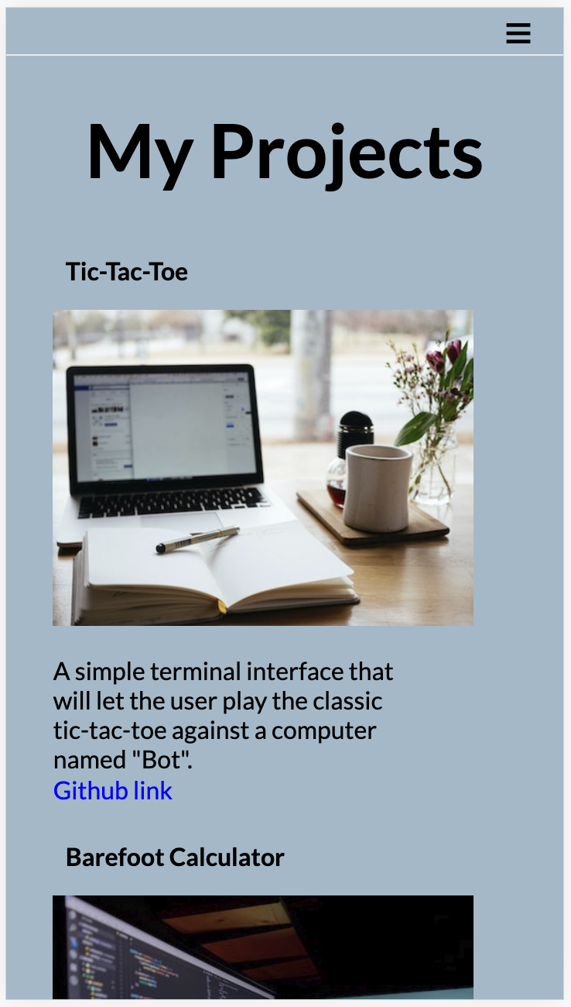
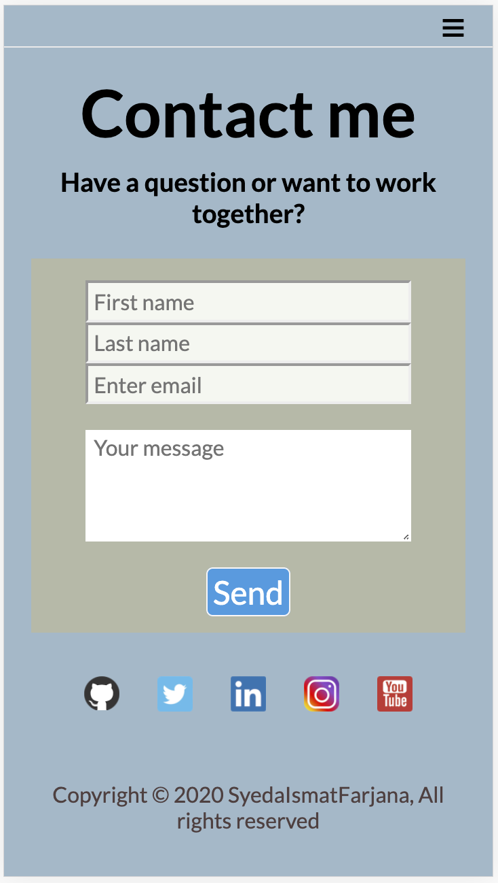
Live (Mobile)

Slide 5
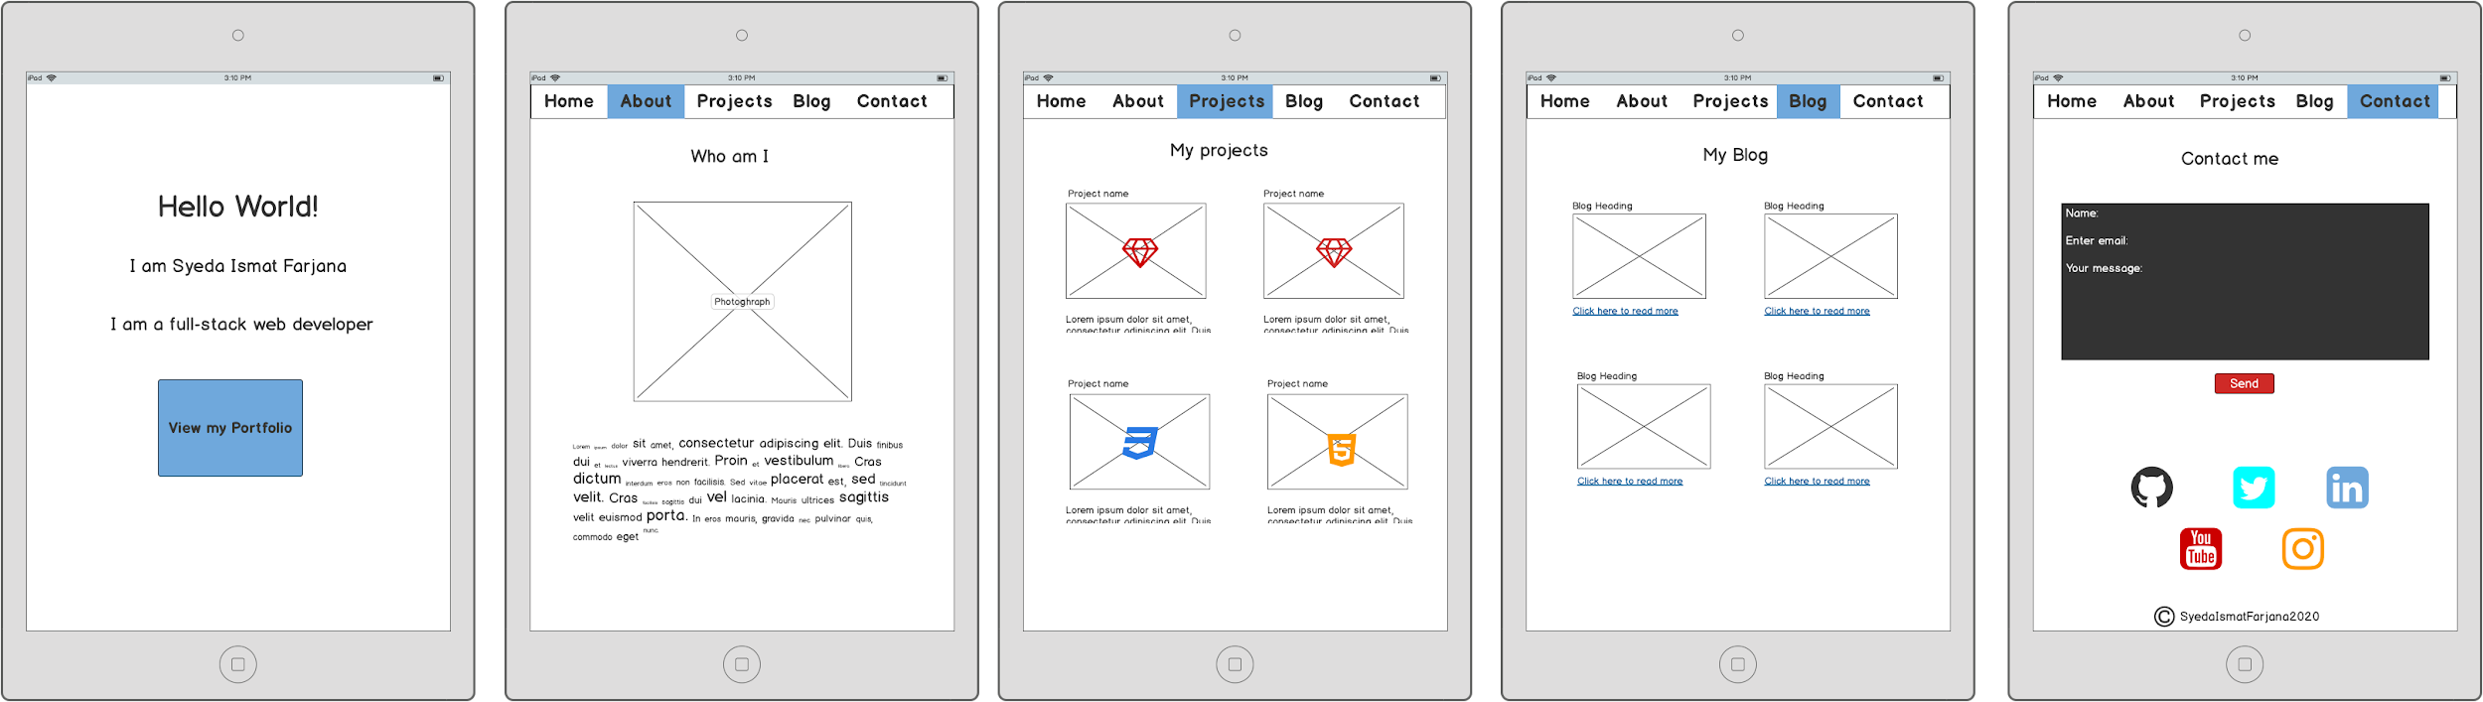
Wireframes (Tablet)

Slide 6
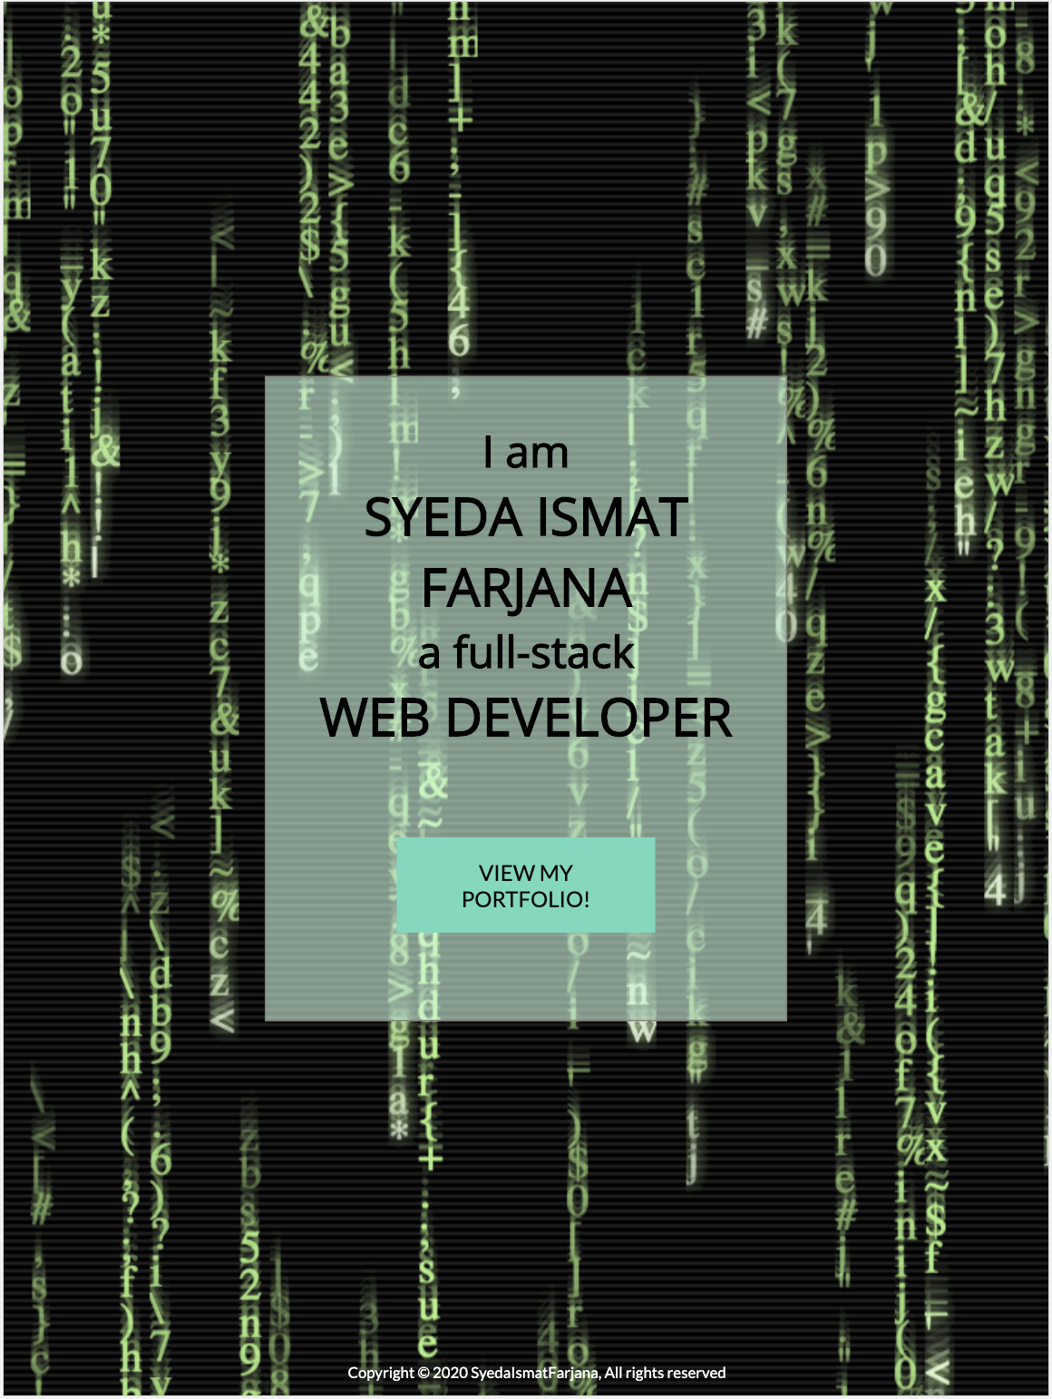
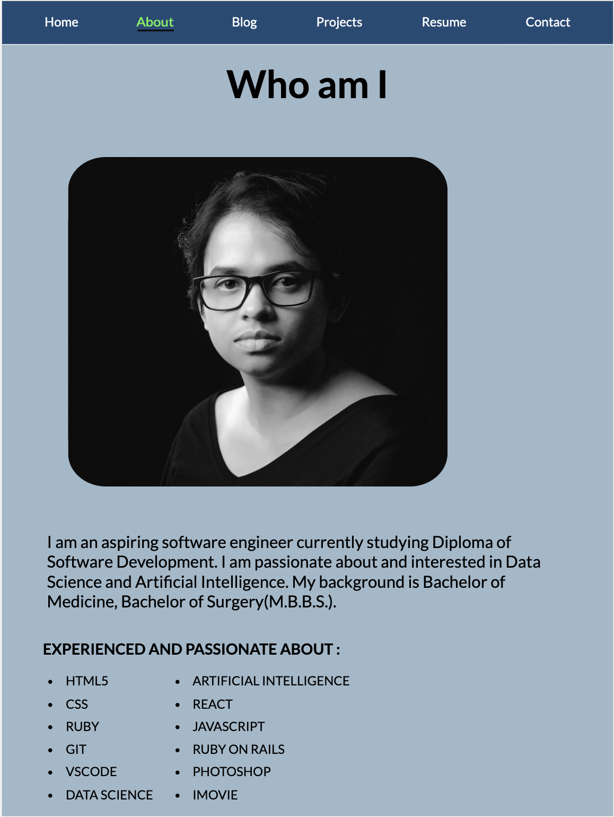
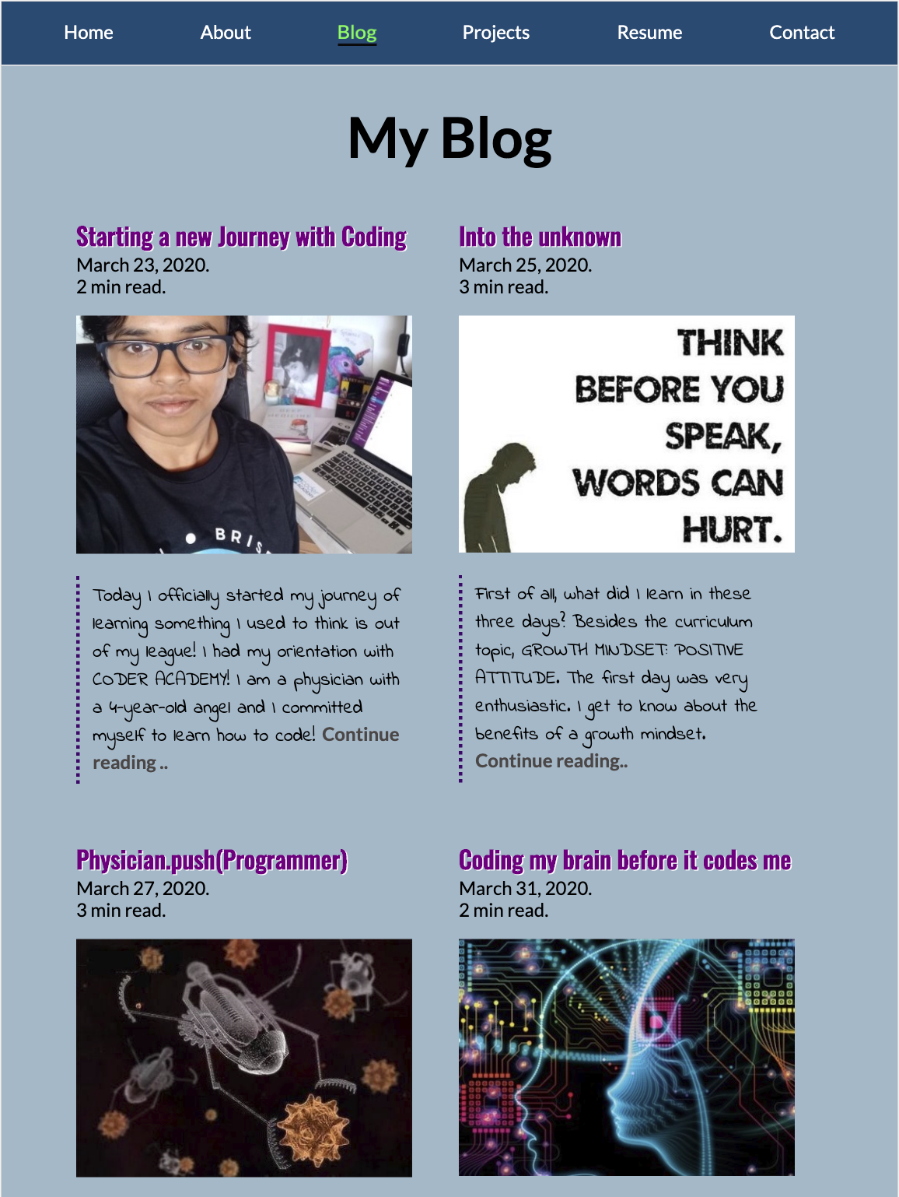
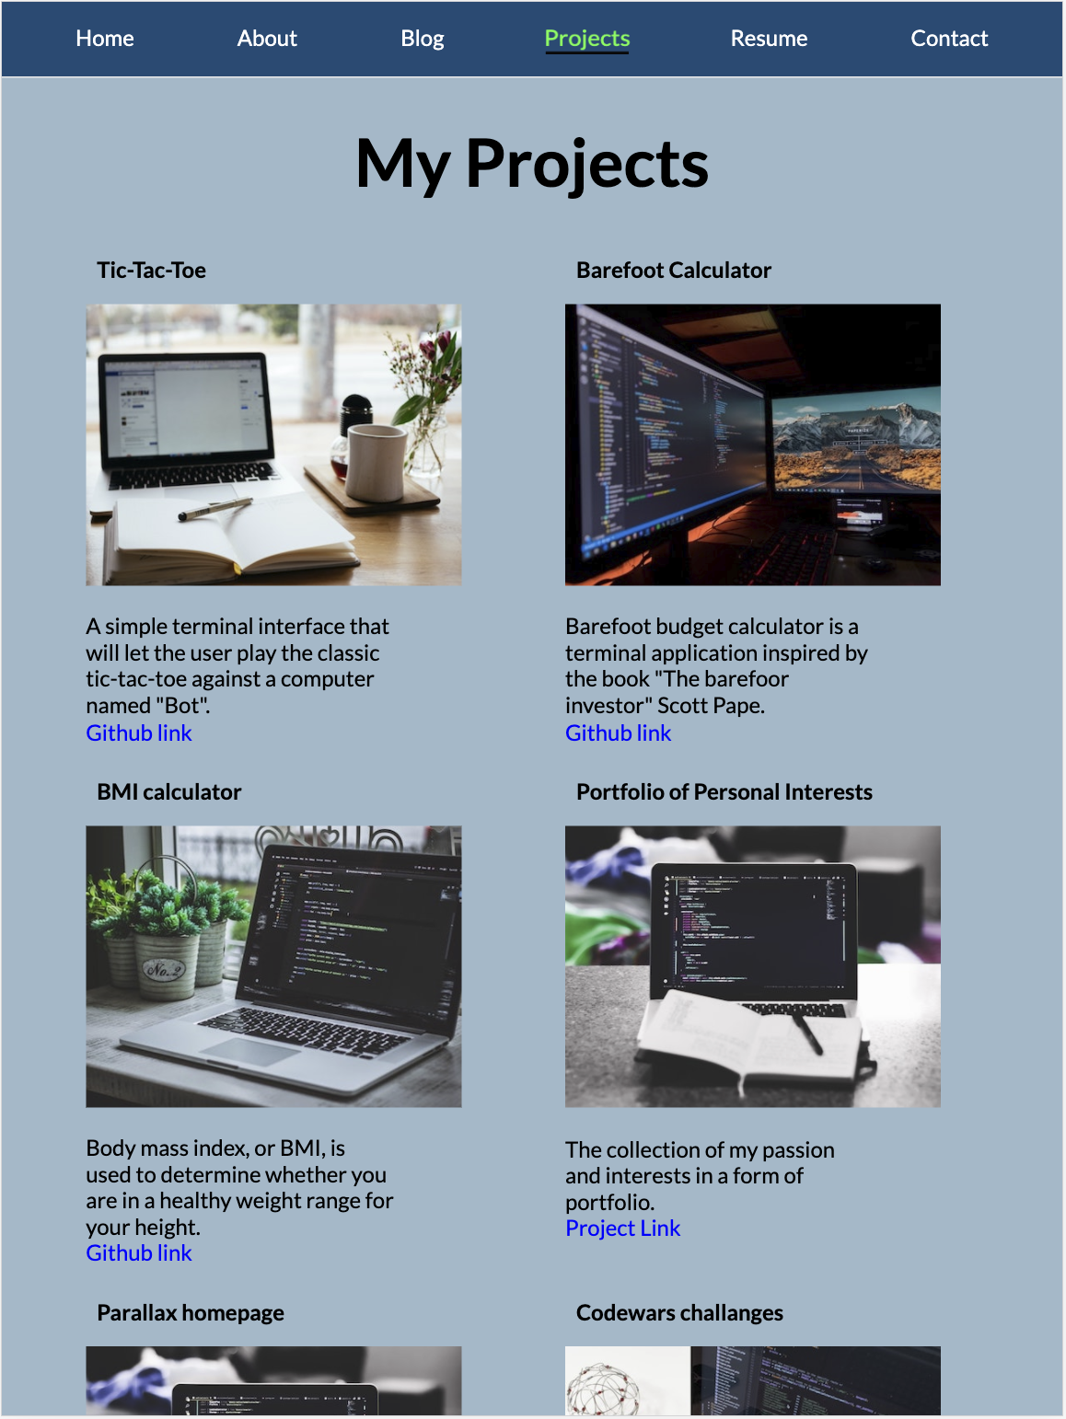
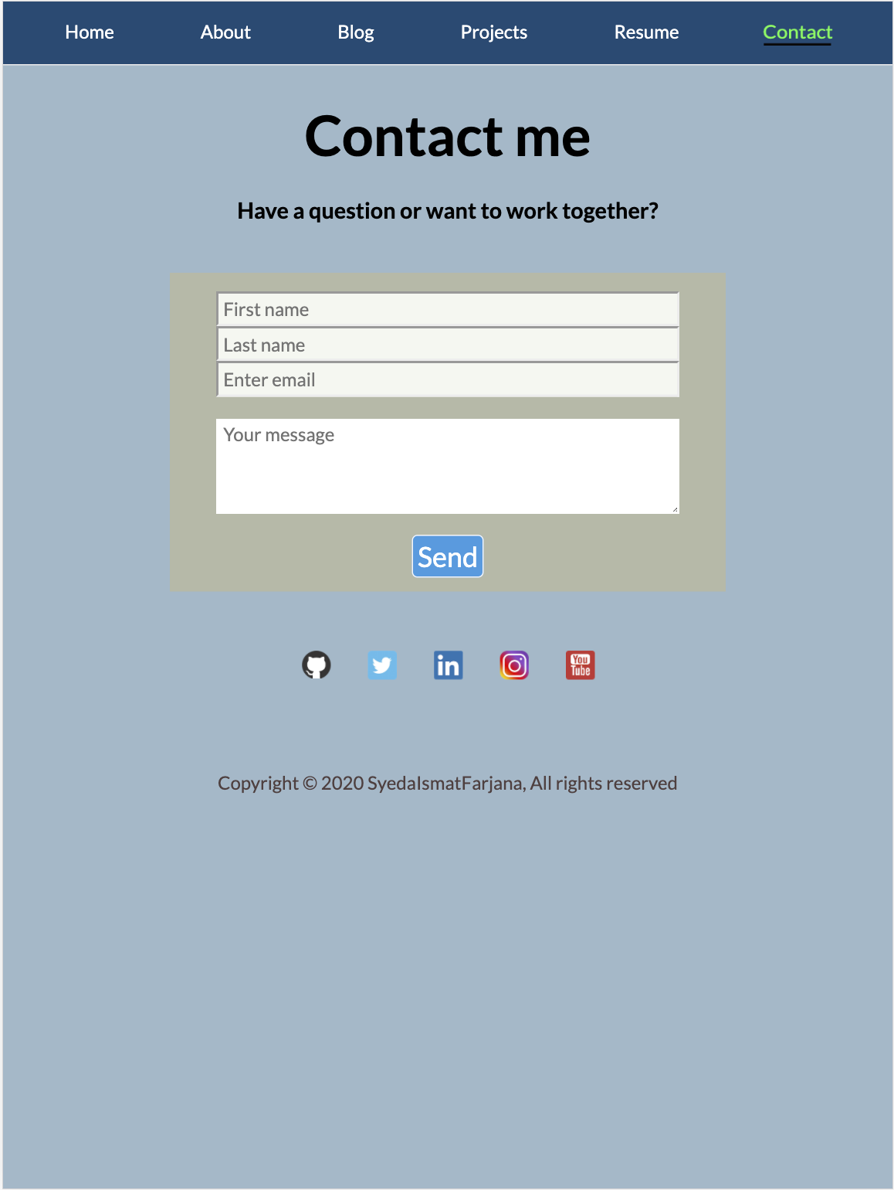
Live (Tablet)

Slide 7
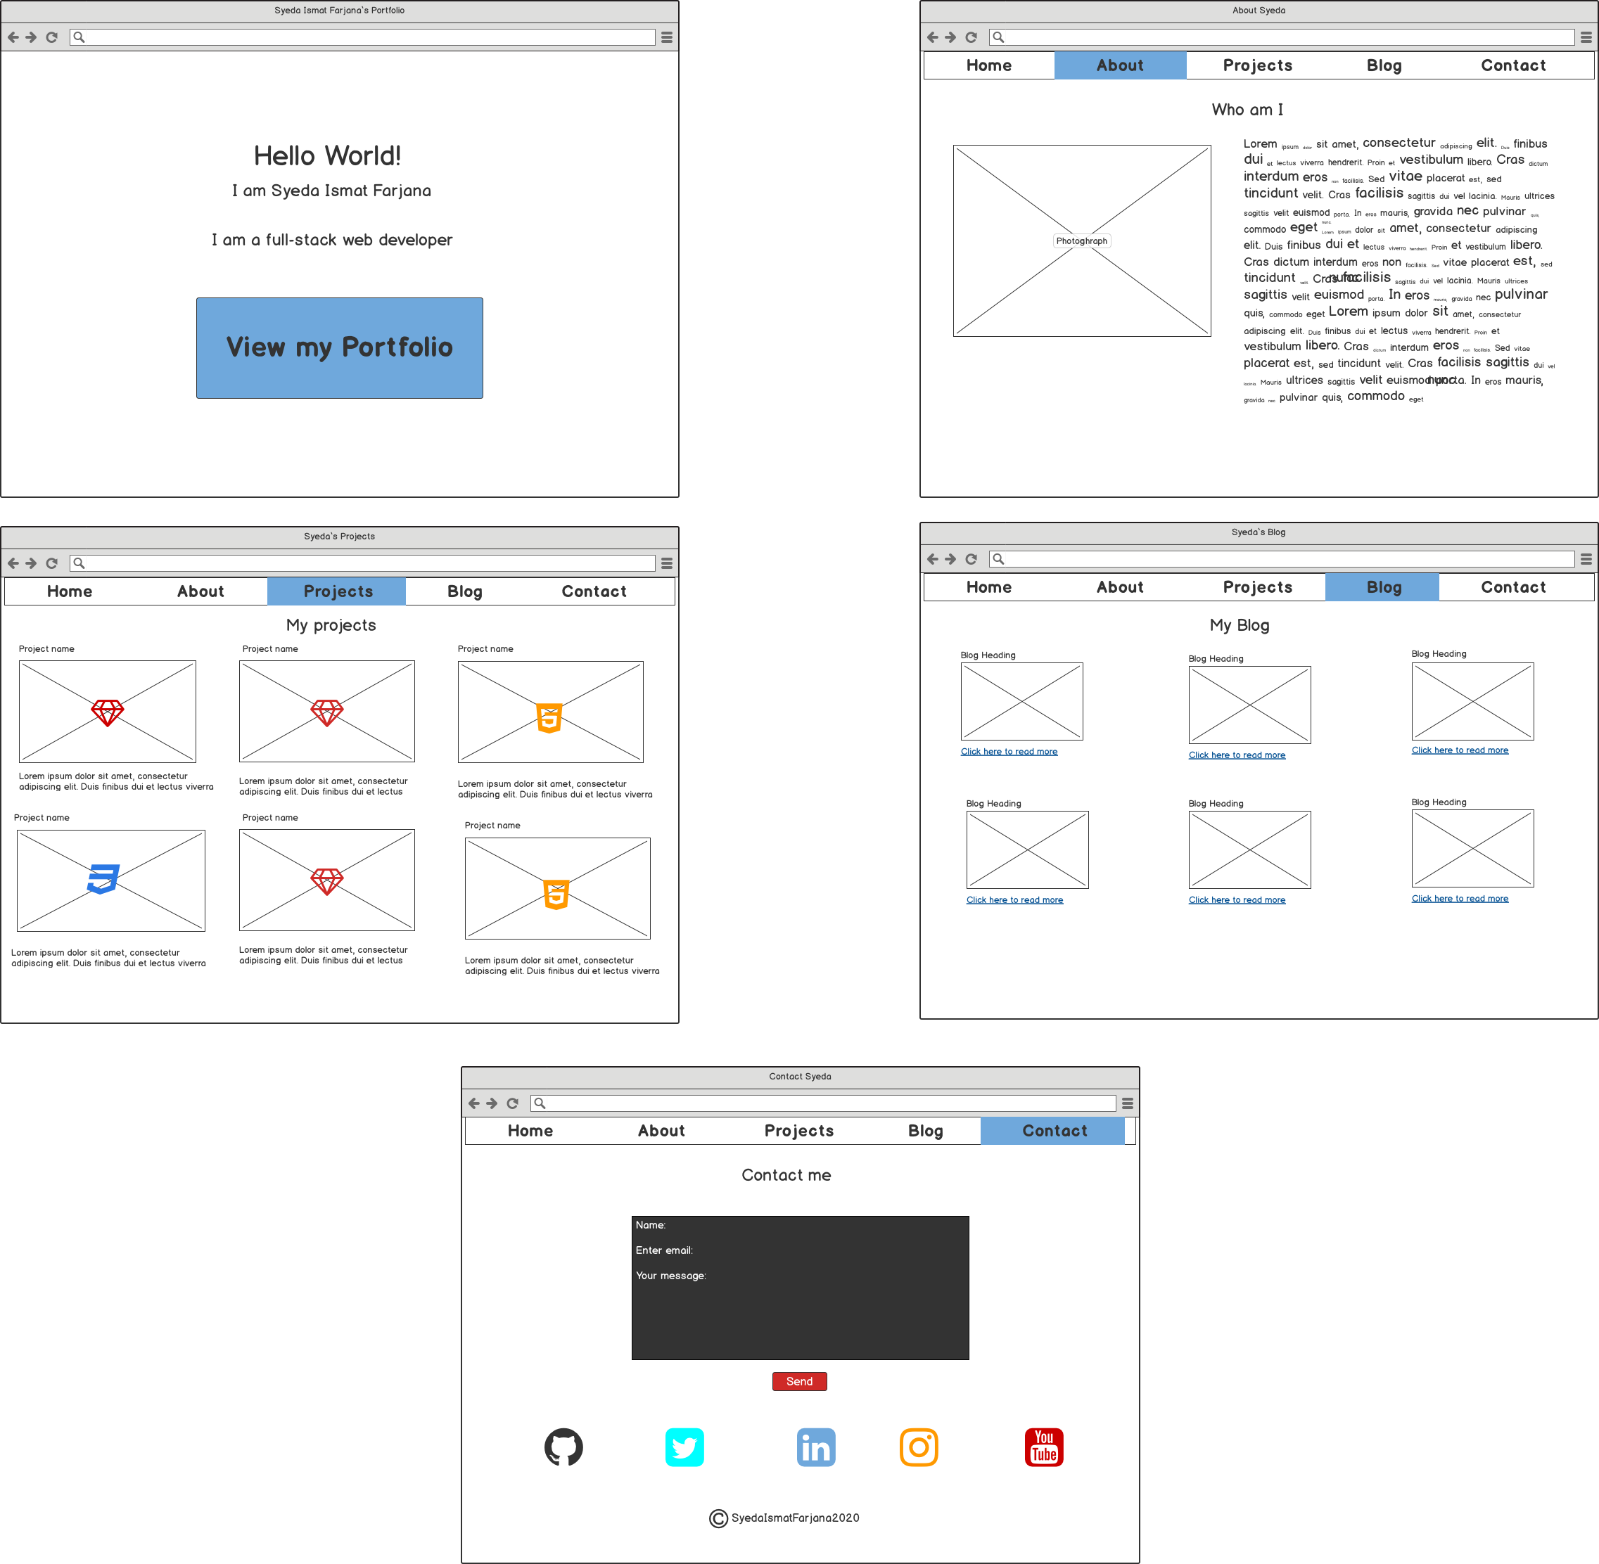
Wireframes (Desktop)

Slide 8
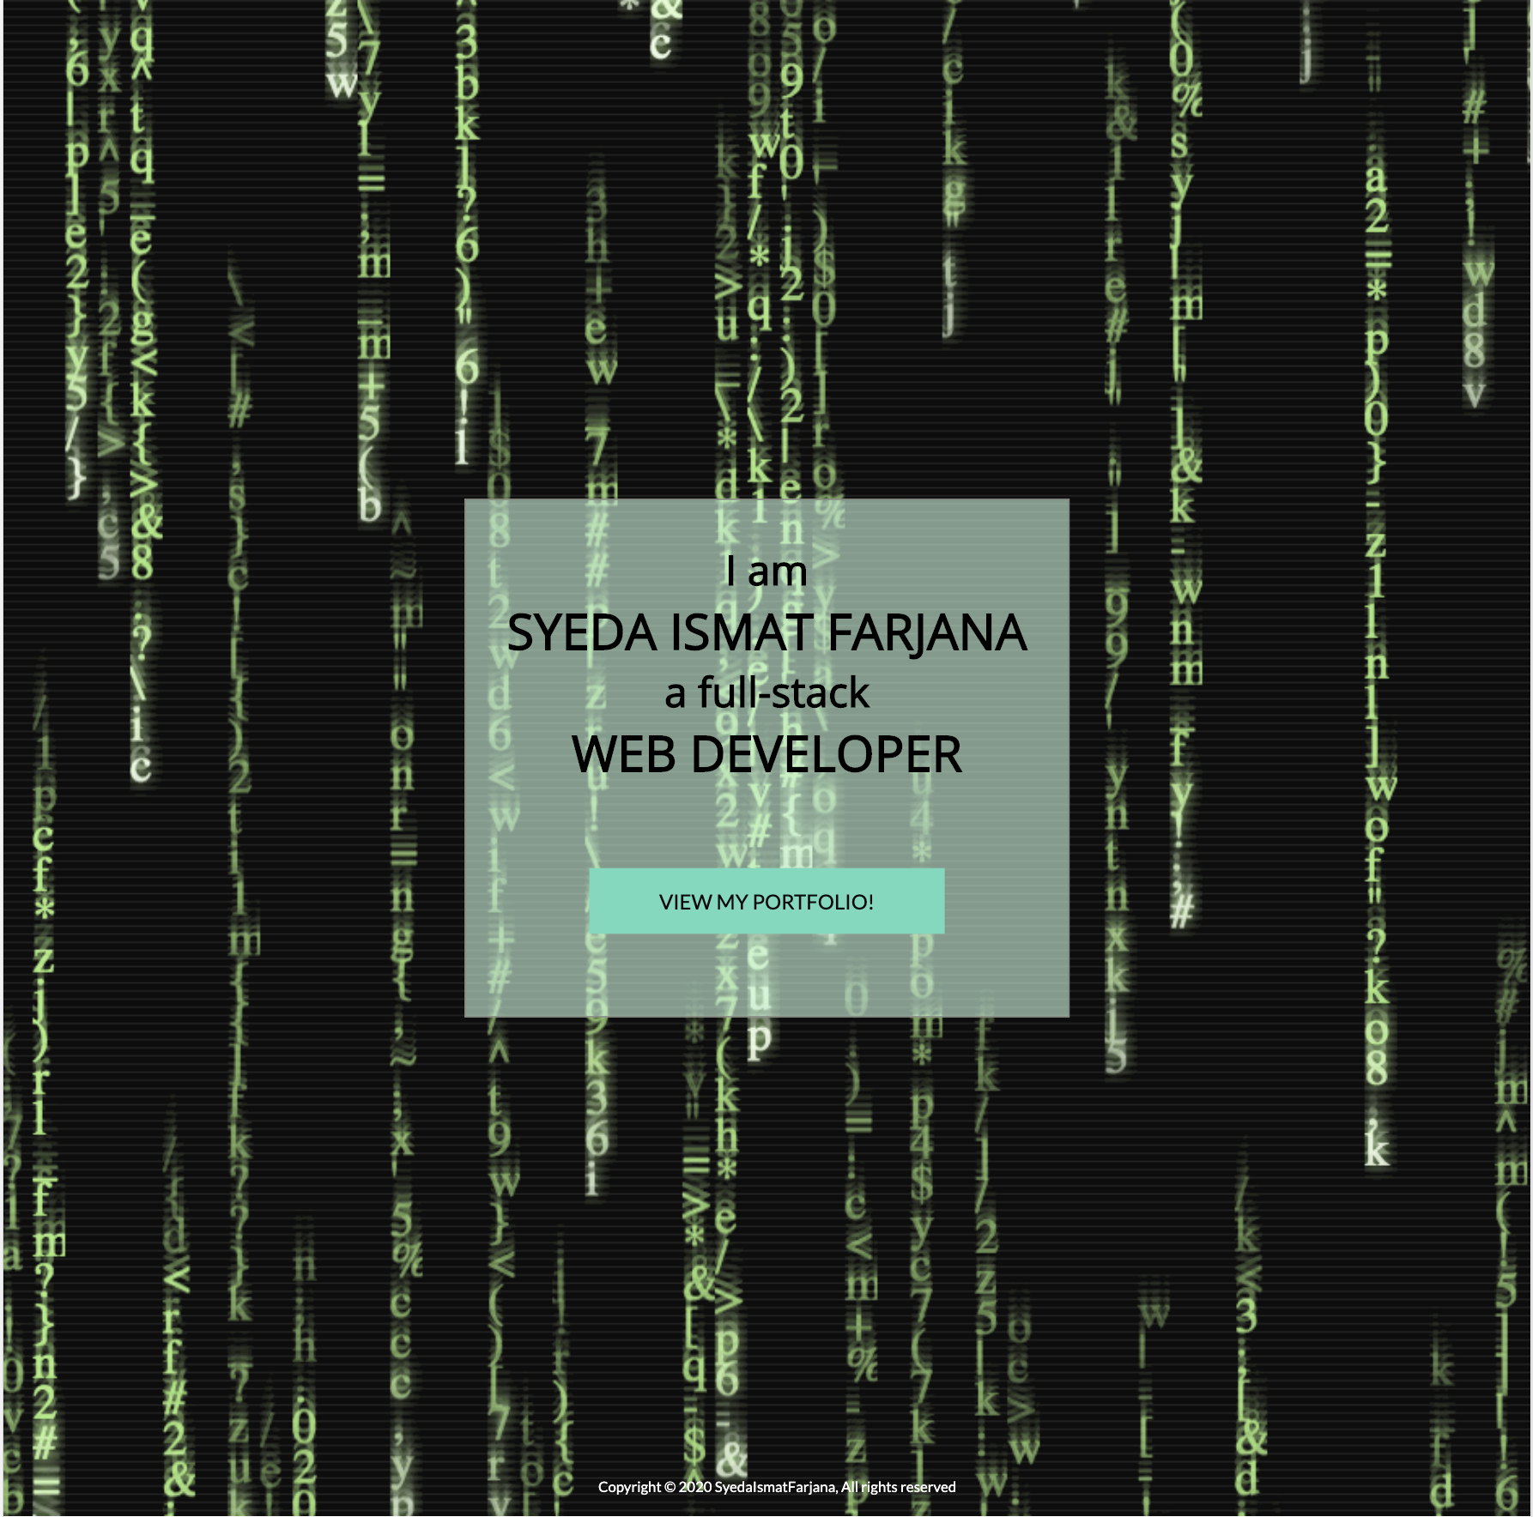
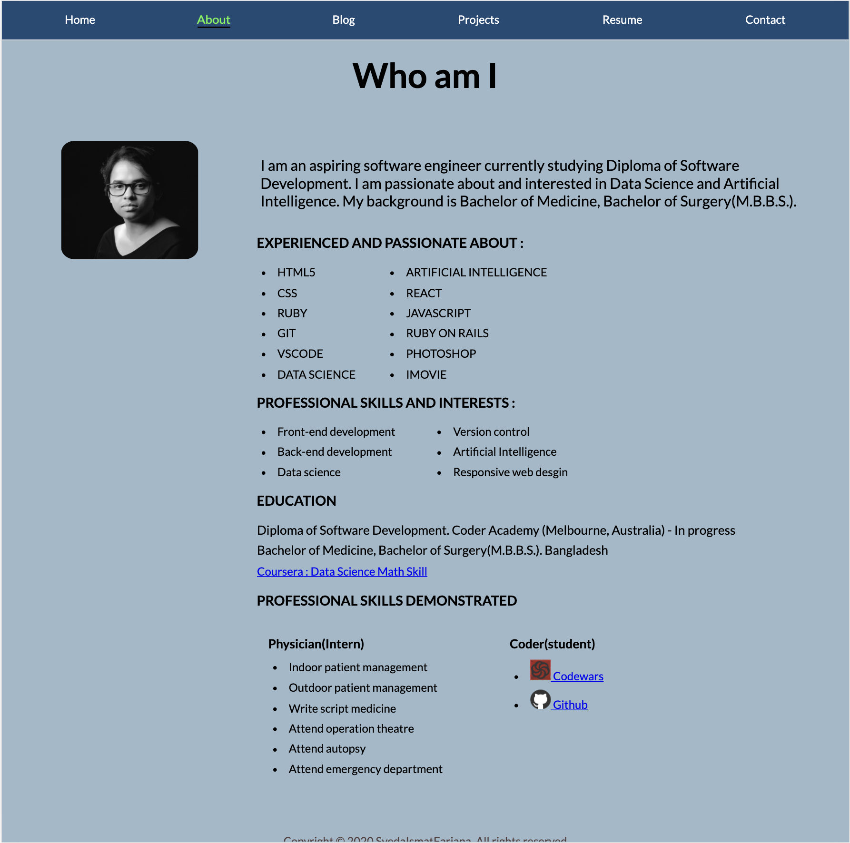
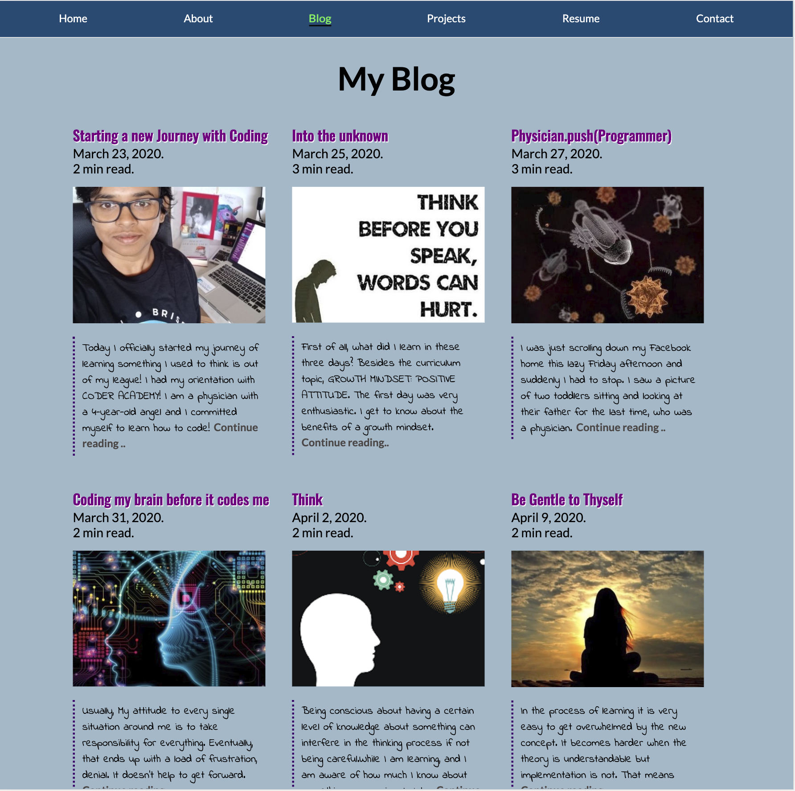
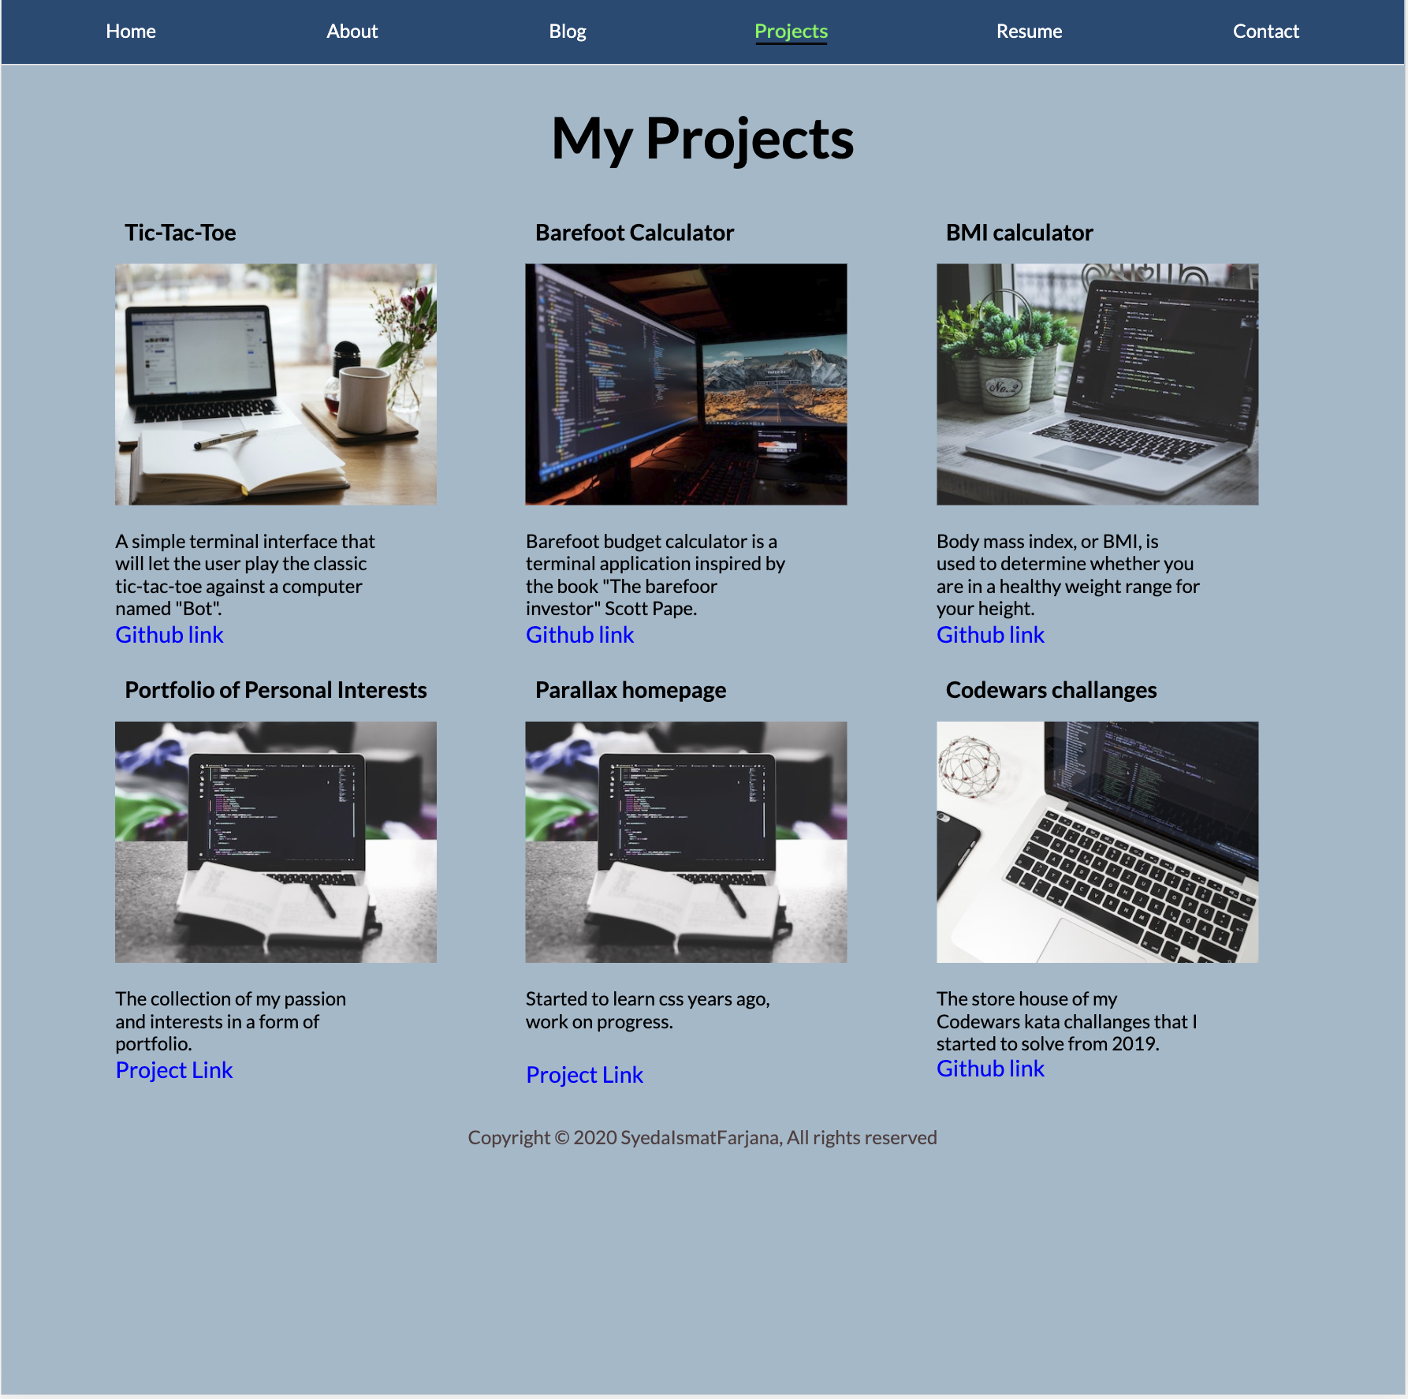
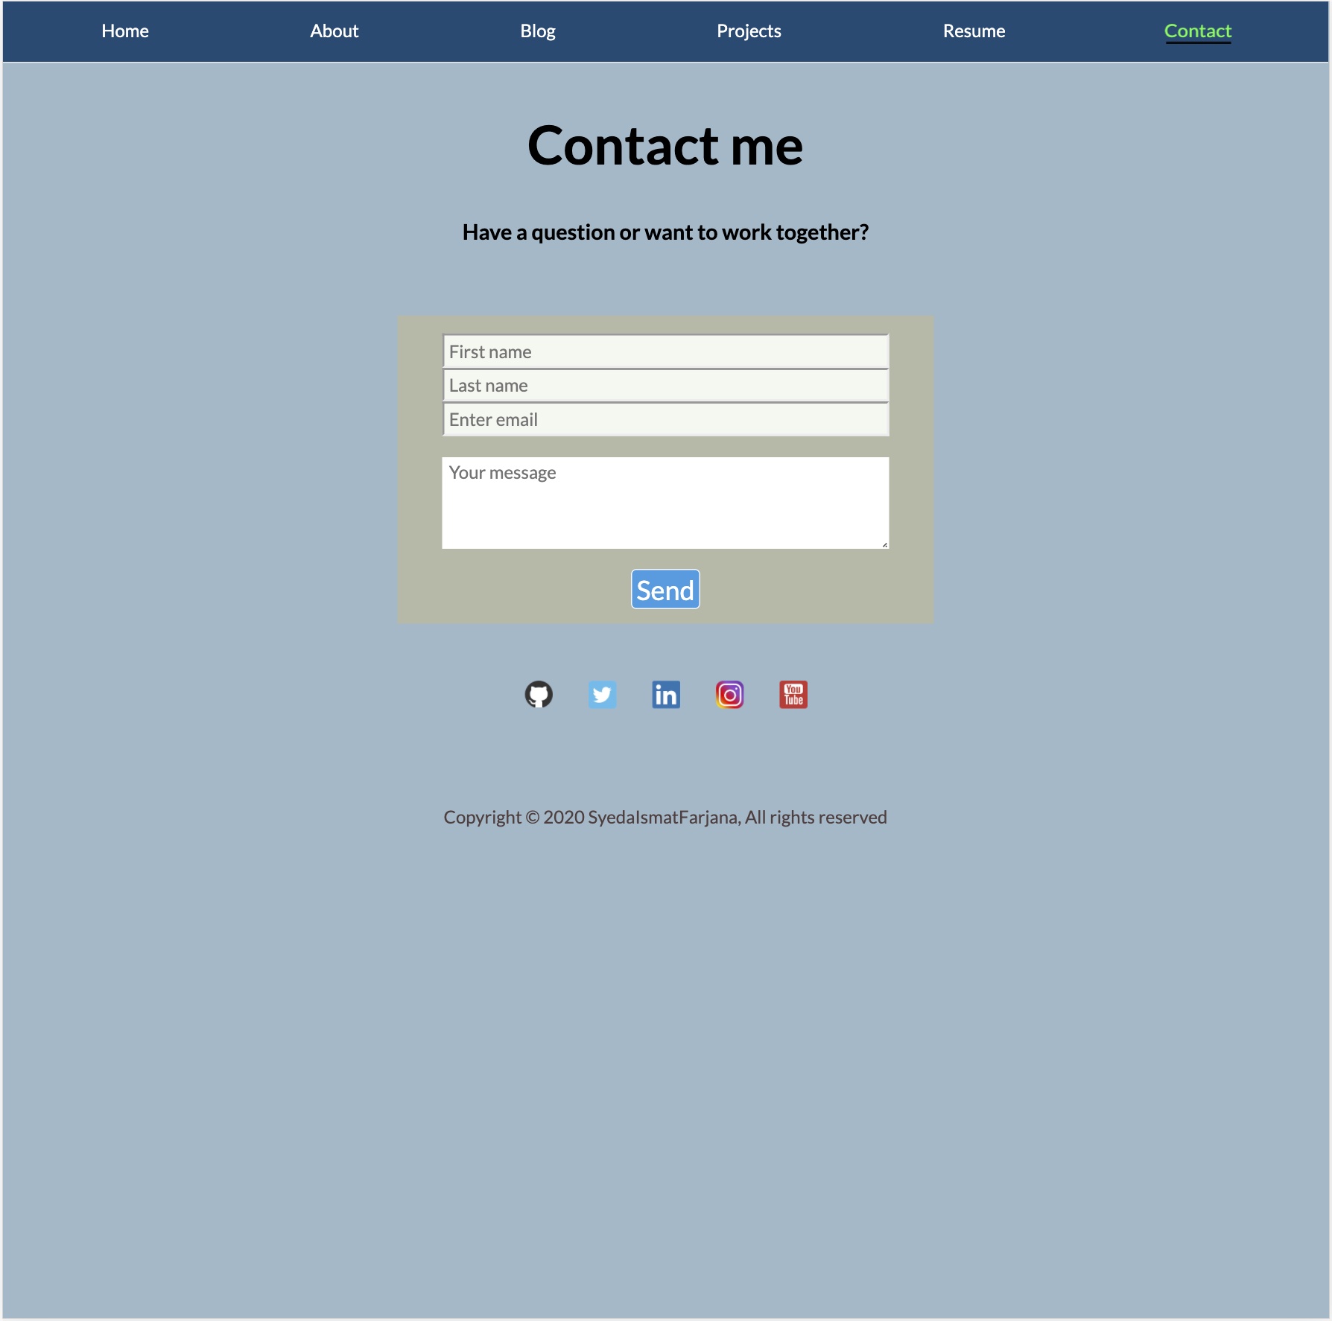
Live (Desktop)

Slide 9
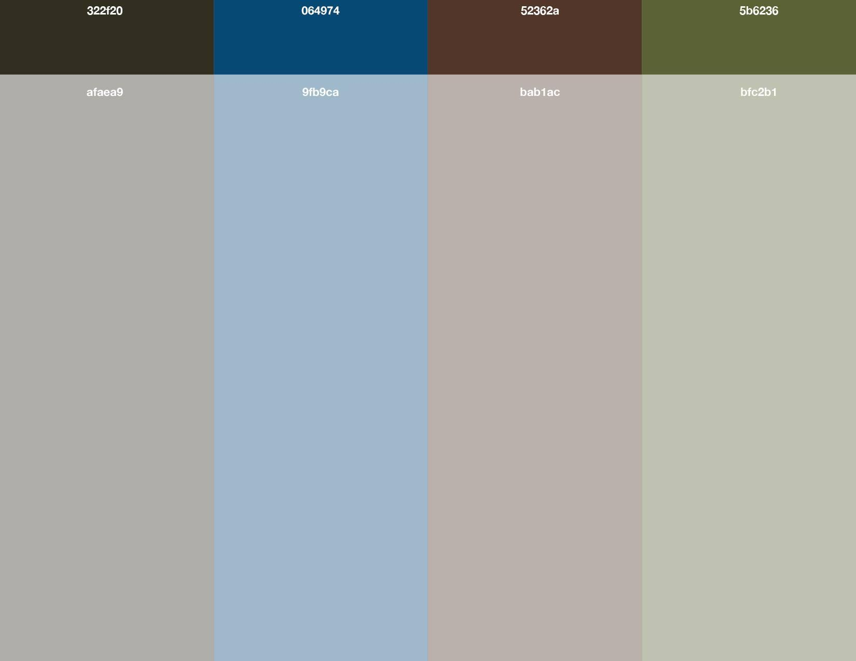
Color palette
Initially choose 4 color palettes
Ended up using #9fb9ca

Slide 10
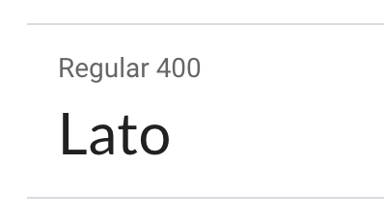
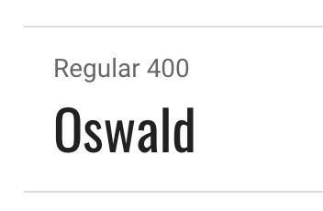
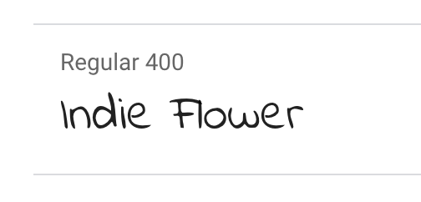
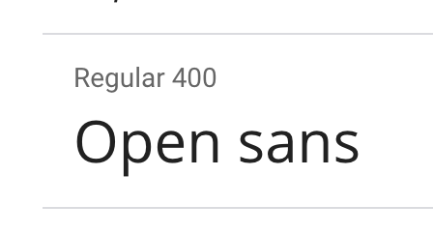
Fonts
Lato
Oswald
Indie Flower
Open Sans

Slide 11
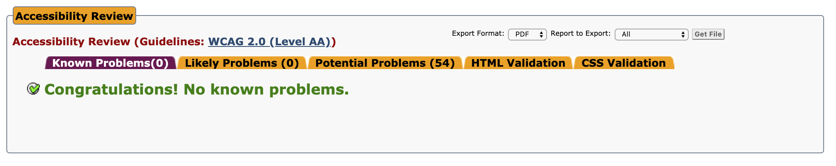
Accessibility
Used semantic HTML and Colors that does not impact user that has issues with different color to address accessibility issues.
Accessibility test done using https://achecker.ca/checker

Slide 12
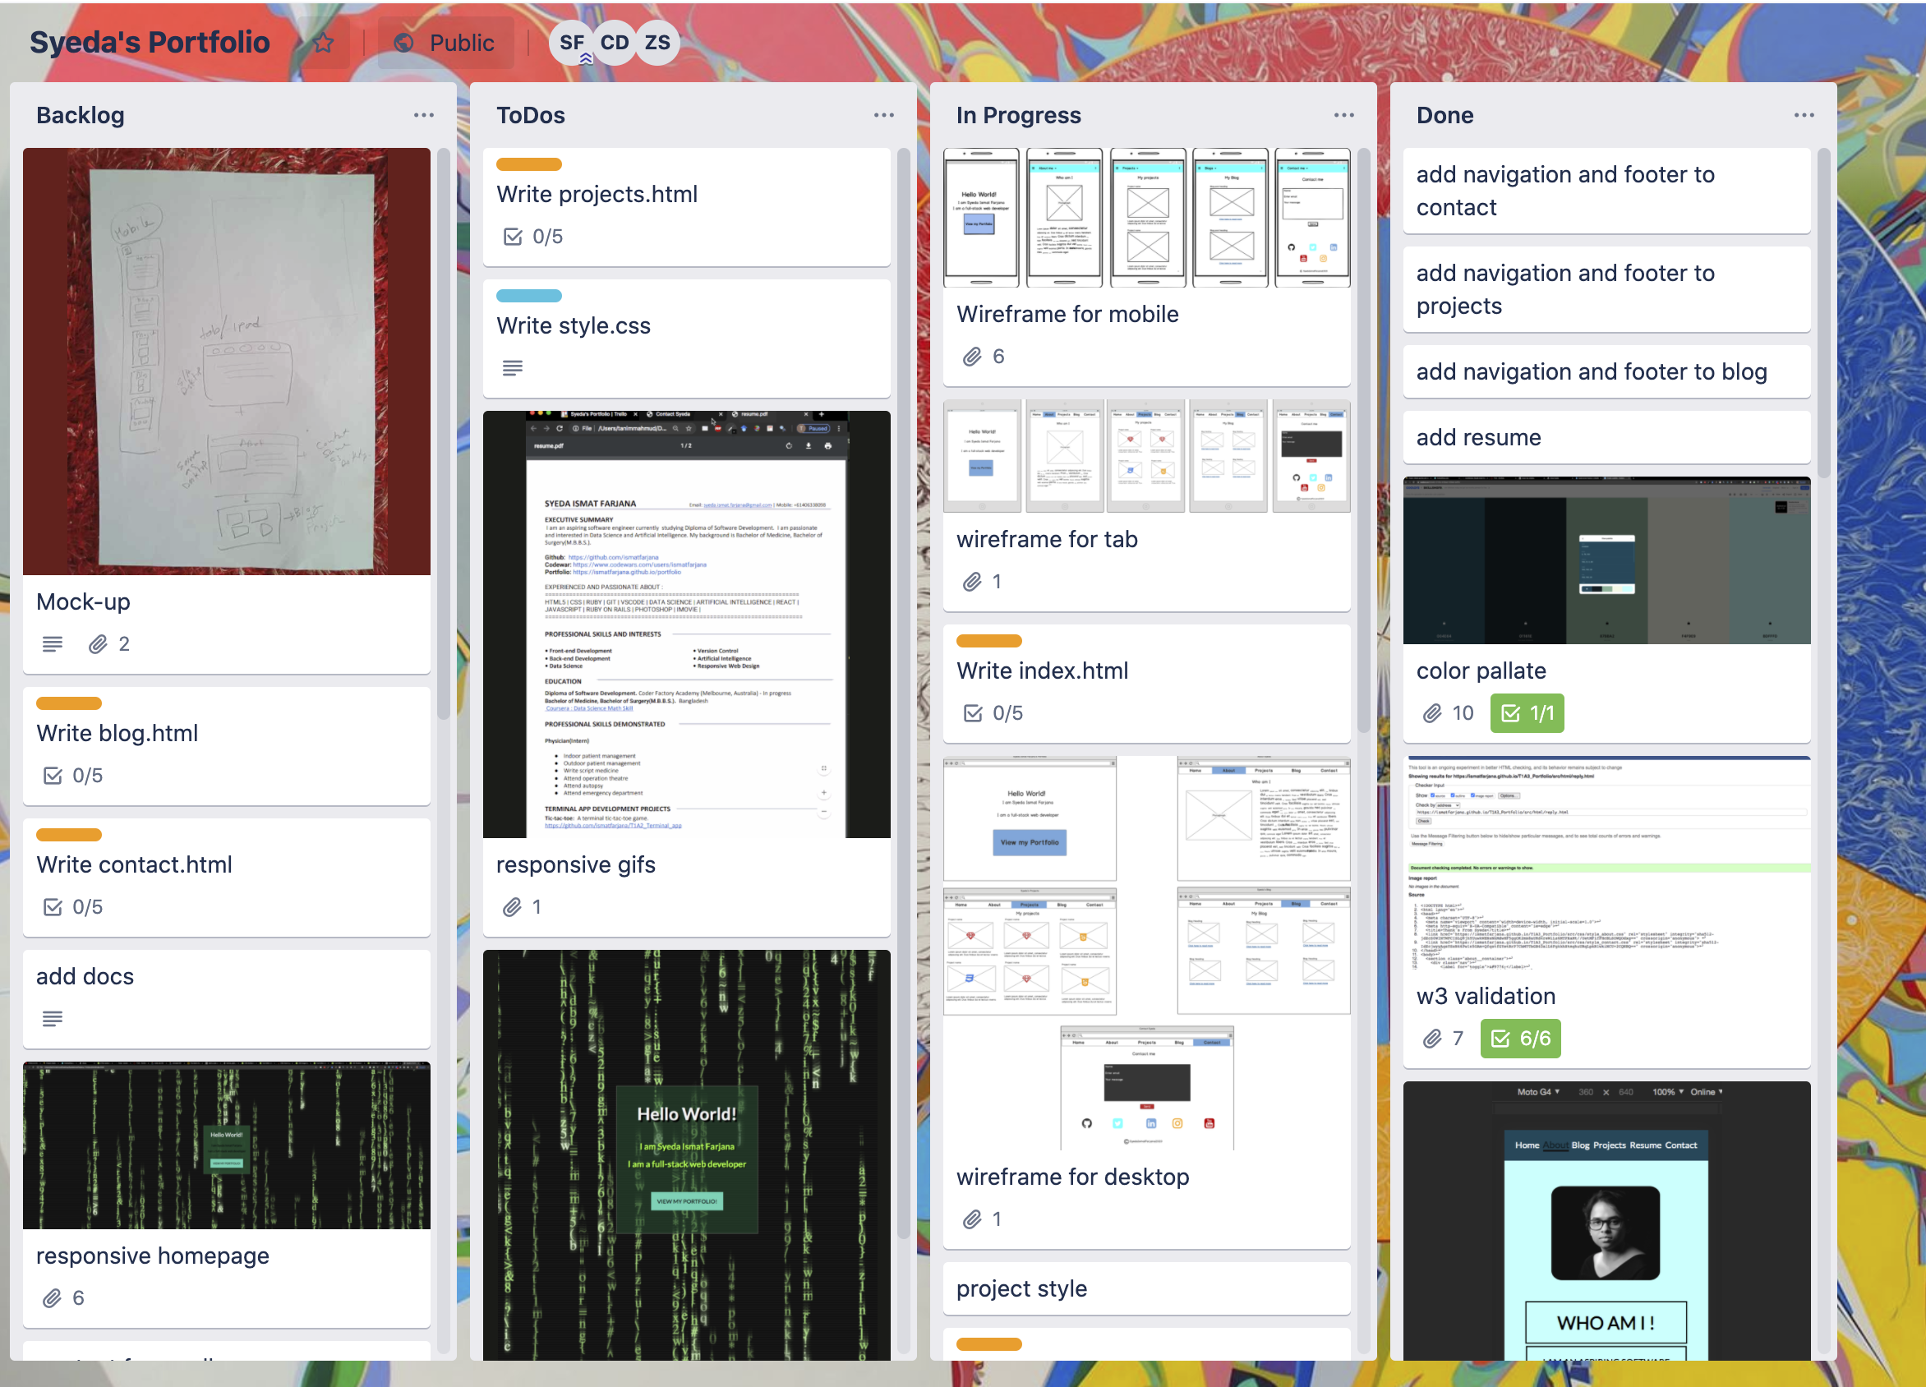
Development process
Used Trello for user stories and project management
Used Balsamiq to draw wireframes
Git to create branches for different features.

Slide 13
Challenges
SRI Hash
Accessibility
W3C validator
Responsiveness
Hamburger menu

Slide 14
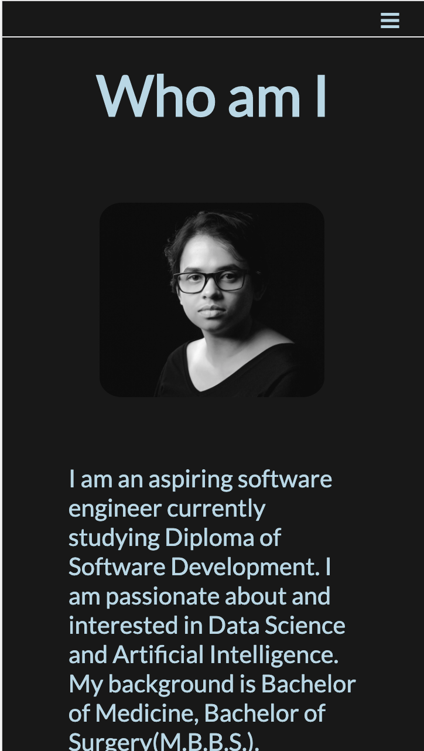
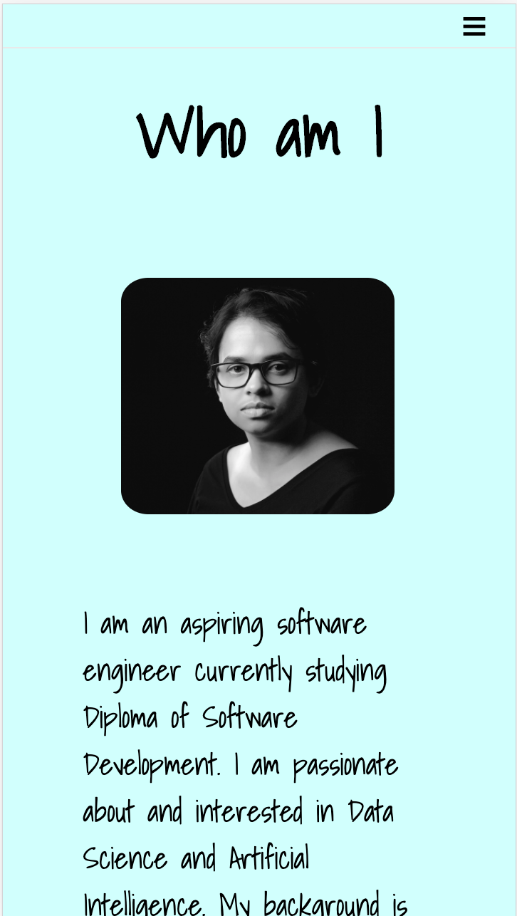
Favourite parts
Creating different themes

Slide 15
Engaging Factors
Moderate colors
Easy to find navigations
Easy to follow language
Properly highlighted text and images

Slide 16
Future Improvements
Accessibility
Add more css carisma
Implement sass
Add some interactions with JavaScript

Slide 17
Thanks for your time

